Slide 1
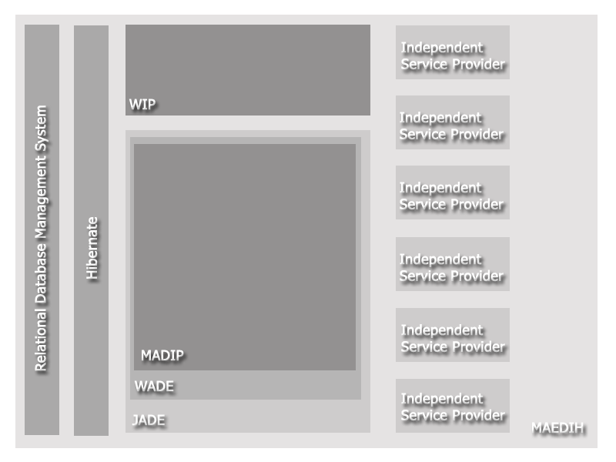
University of Minho School of Engineering Computer Science and Technology Center
ARCHETYPE BASED INTELLIGENT SYSTEM FOR HEALTHCARE INTEROPERABILITY
MIGUEL MIRANDA
Supervisors: José Machado, José Maia Neves
{miranda,jmac,jneves}@di.uminho.pt
Contextualization
Currently, information technologies acquired a key role on the flow of work, information and knowledge within healthcare institutions determining their inner functioning to an extent previously unexpected.
However the flow of information is of the essence for service cooperation:
The healthcare environment is clearly cooperative;
All services collaborate and need each other;
Implicating the continuous flow of information among all information services in this environment;
A secluded system will cause information inconsistency.
INTEROPERABILITY
Interoperability is a process which implies:
Exchange of information among heterogeneous systems;
Mutual understanding of the communicated information;
Mutual benefits in information exchange;
Easy coupling of new systems without costs for the client
Objectives and core architecture
Main objectives:
Develop an environment for interoperability based on multi-agent systems embedded with intelligent behaviors, which improve the quality of the exchanged information and the overall systems reliability
Propose an implement archetypes to imbed artificial intelligence within the core of the agent systems in order to inherently increase their interoperability level
Evaluation of the results and methodologies proposed based in the collected using prototypes and production versions
Core architecture
Multi-Agent Distributed Interoperability Platform (MADIP)
Web Interoperability Platform (WIP)
Relational Database System(SBDR)
Development backbone
The system was developed under the Java Agent DEvelopment Framework and the Workflows and Agents Development Environment (WADE) – both open-source and developed by the TILabs of Telecom Italia
JADE at its core has several basic core capabilities:
provides a stable framework for the development and extensions of multi-agent systems
Follows the specifications of agent communication and platforms of da FIPA (Foundation for Intelligent Physical Agents)
It provides several encodings for agent communications such as FIPA Sematic Language (SL) and XML
In order t complement the Agent Communication Language (ACL), it provides an ontology server which allow to map ontologies with JAVA plain objects
WADE provides additional and important capabilities:
Workflow modelling
Improvements in platform administration and distribution in physical elements
Dynamic agent allocation policies with the RAA Agent
Additional agents an techniques of failures prevention and response
Different ontologies where natively added for communication of agents and external systems:
Internal ontology – more dynamic and intended for agent communication
HL7 Ontology – an ontology based on the HL7 v2 protocol
Current development phase
Currently several prototypes are being implemented in Centro Hospitalar do Porto for interoperability processes, namely in this specifics cases:
CICA – interoperation with the SOA layer of the Centro Integrado de Cirurgia de Ambulatório of the Centro Hospitalar do Porto
GEO – Geographic positioning and patient demographics
AIDA – Integrations and diffusion of information within an existing integration platform
Aknowledgements
This PhD project is supported by the grant SFRH/BD/65023/2009 of the Portuguese Foundation for Science and Technology (FCT)
Existing healthcare interoperability limitations
Information that is vital and must be shared is usually either isolated or shared using unstable or complex connections
Most common solutions use end-to-end architecture even when applying communication standards such as Health Level 7 (HL7)
Even when applying standards the communications among service providers is highly flavored
High levels of interoperability such as semantic interoperability are rarely attained
Uma Escola a Reinventar o Futuro – Semana da Escola de Engenharia - 24 a 27 de Outubro de 2011

