Slide 1
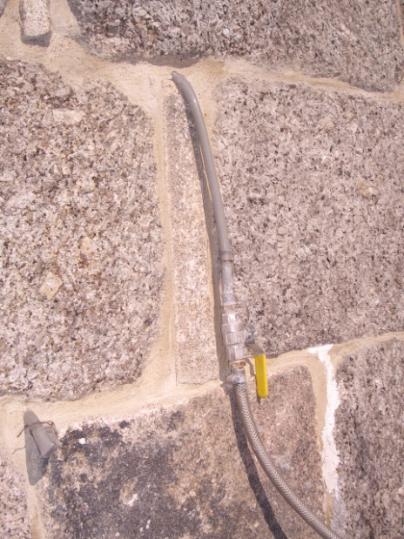
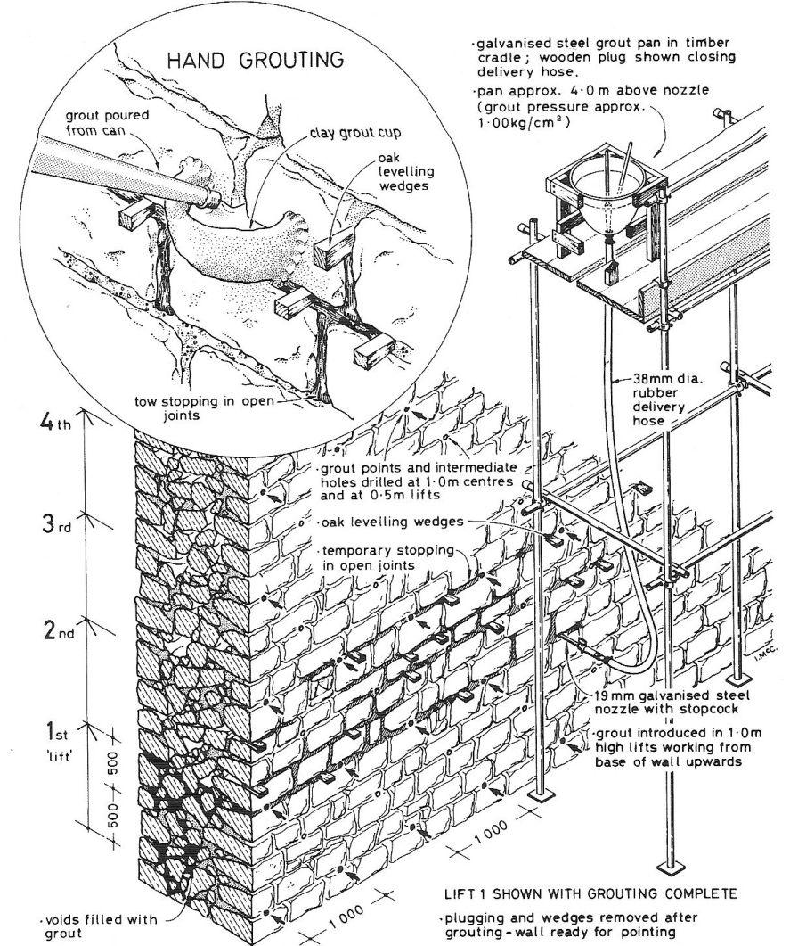
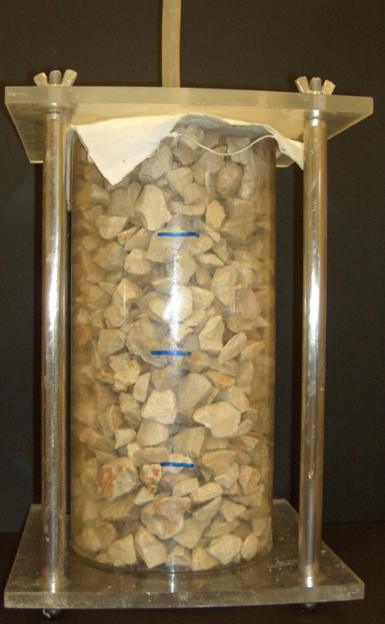
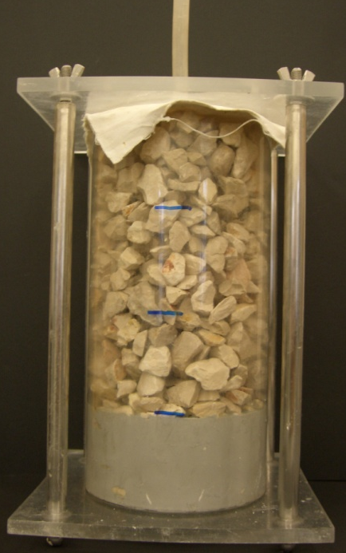
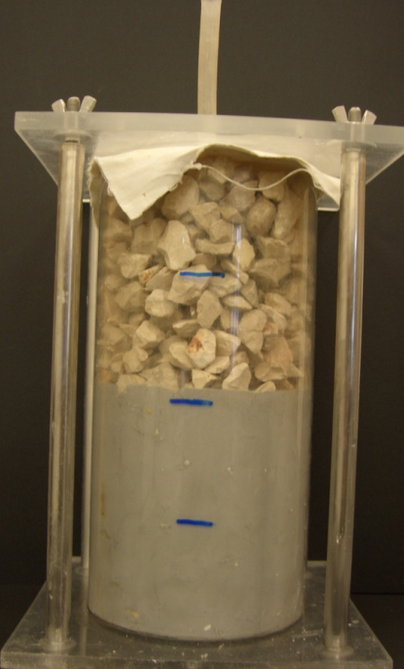
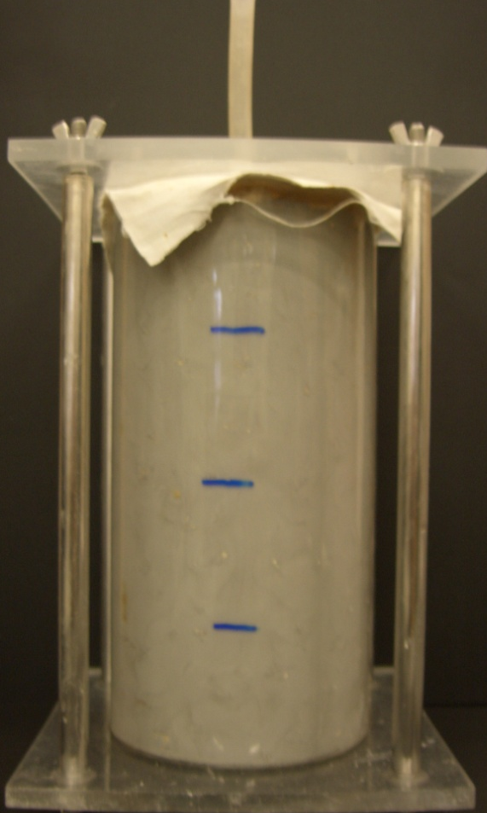
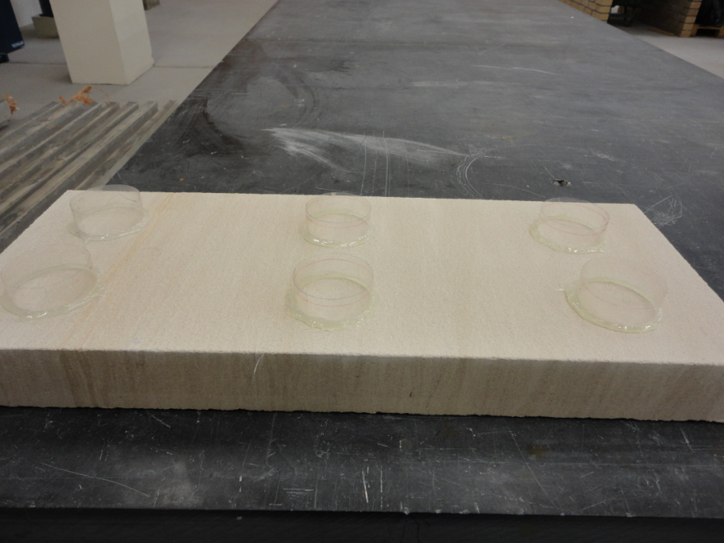
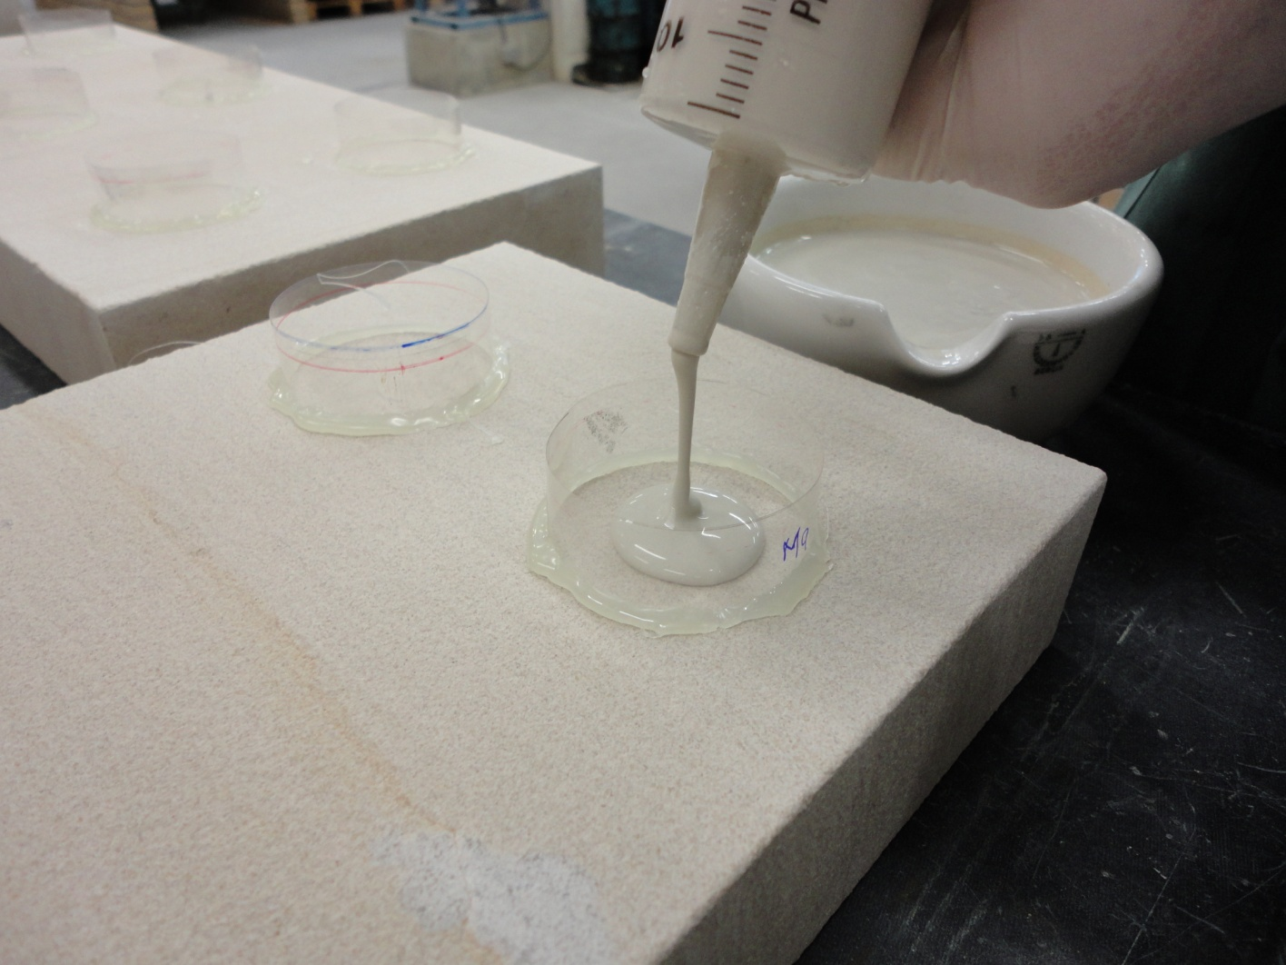
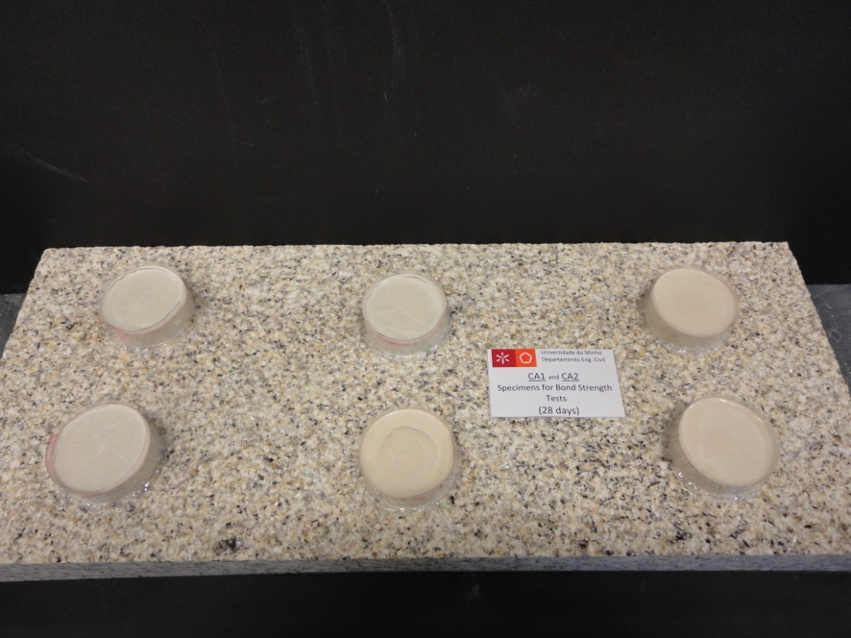
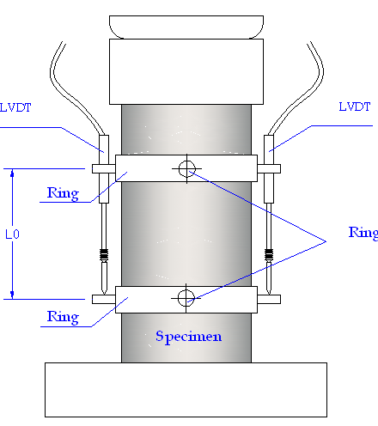
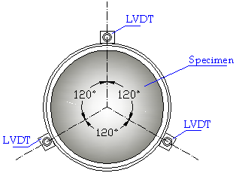
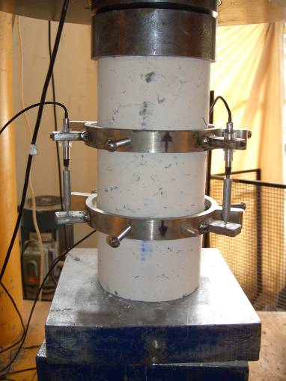
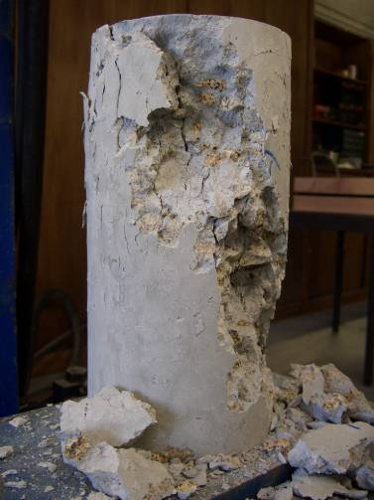

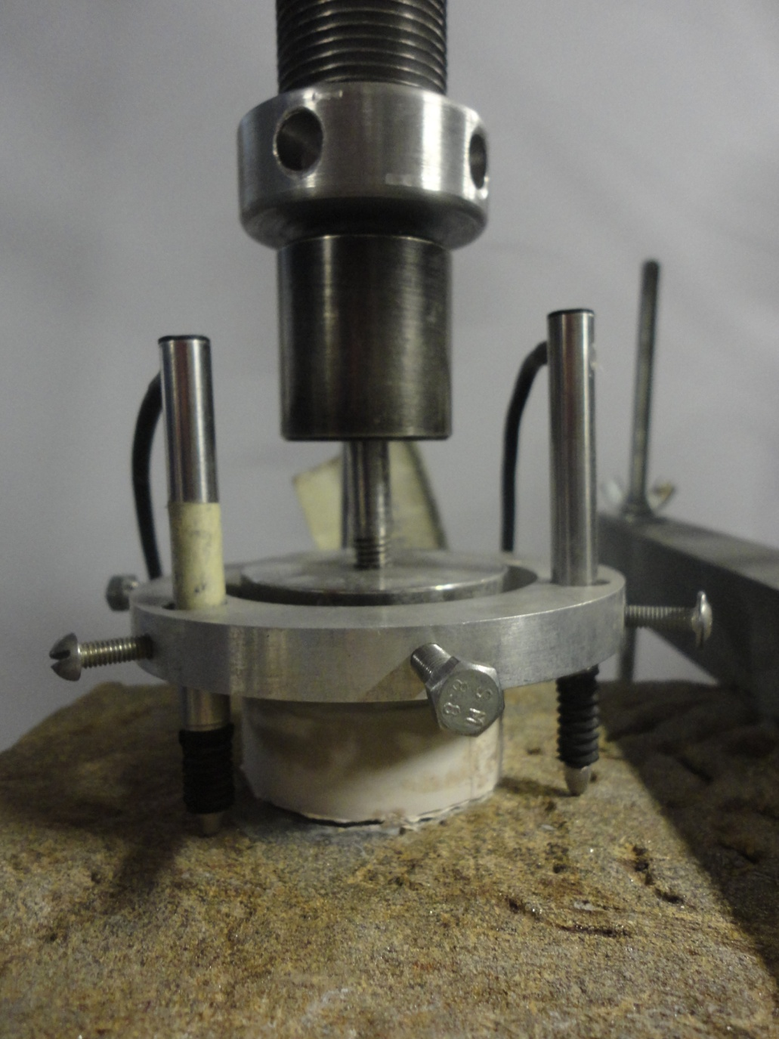

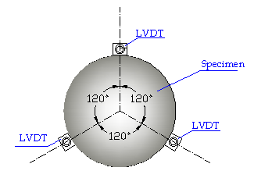
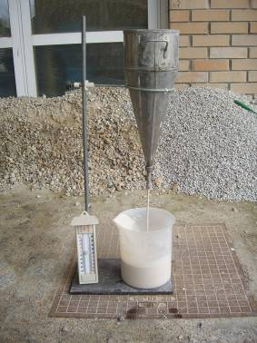
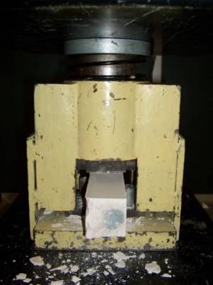
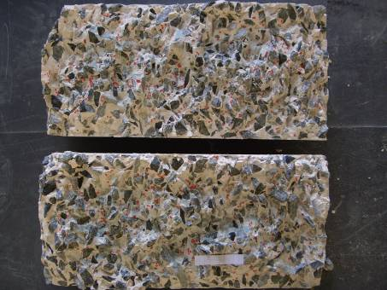
University of Minho School of Engineering ISISE, Department of Civil Engineering
EXPERIMENTAL CHARACTERIZATION OF COMMERCIALLY AVAILABLE GROUTS FOR USE IN MASONRY STRUCTURES
Author* EDUARDA LUSO
Supervisor: Paulo B. Lourenço; Co-Supervisor: Rui Miguel Ferreira
* eduarda@ipb.pt
Introduction
Cement and lime-based grouting is a well-know restoration method (fig 1, 2). This intervention technique can be durable and mechanically efficient whilst preserving the historical nature of the structure. The selection of an injection grout for a repair should be based on both the physical and chemical properties of the deteriorated mortar.
Some laboratory tests were conducted to determine the properties of commercially available (CA) grouts used to repair masonry: flow time (fig. 3); bleeding; segregation; compressive strength, (fig. 4).
Injectability characterization of commercially available grouts
Injection grout is evaluated not only in terms of fluid consistency and homogeneity, but also injectability and penetration.
Using different stones, cylinders have been prepared into plexiglas moulds of 150mm diameter and 300mm height in order to reproduce in laboratory typical Portuguese masonry walls, (fig. 5, 6, 7, 8).
Bond strength characterization of commercially available grouts
The main property affecting the behavior of grouted walls is the shear bond strength of the grout-stone interface.
The tensile strength of the interface between grout and the stone, demanded the preparation of composite specimens with the four CA grouts available and three different stones: Limestone, shale and yellow granite.
The specimens were prepared with the help of a transparent film stuck to the stone, which served as a mould. The grout was placed with a syringe, (fig 12,13).
A week before the test a circular metal plate adapted for the tensile test equipment was glued with an epoxy and tensile tests at the age of 28 and 90 days are being performed, (fig 14, 15).
In graphic 5 the experimental result on the tensile bond strength of the interface between the Ma grout and yellow granite is presented.
The main objective of this study is to assess the physical, mechanical, injectability and bond strength characteristics of some commercially available grouts: Ma, Ab, Li and Cc.
[In Ashurst, J. et al., 1988]
The four different CA grouts were injected, with a pressure of 1,5atm using a “pressure pot”.
The time for the grout to reach the top of the cylinder was measured.
fig. 1
fig. 5
fig. 6
fig. 7
fig. 8
Physical characterization of commercially available grouts
A grout to be injected into masonry should comply with a set of requirements, namely rheological,
At 28 and 90 days of time cure, uniaxial compression tests were performed with displacement control, (fig. 9, 10) .
fig. 12
fig. 13
fig. 14
fig. 2
physical, chemical and mechanical.
The results of uniaxial compression tests for one of the four CA grouts (Ab) at 90 days is show in graphic 3.
The rheological behavior of the grouts is improved significantly affected by the mixing water temperature (T=10ºC and T=30ºC). One of CA grouts (Cc) presents a very high flow time comparatively to the others.
graphic 3
fig. 9
fig. 10
The values of compressive strength for grouts Ma and Ab are by more 50% higher (14 - 25 MPa) than those obtained for Li and Cc grouts (< 7 MPa), for the three types of stone, (graphic 4). The same occur with modulus of elasticity values (14 - 22 GPa for Ma and Ab and < 6 GPa for Li and Cc).
fig. 15
In some cases, it was not possible to perform the test, because the specimen in the de-moulding process released itself.
Regarding compression tests, it was observed that the same CA grout (Cc) shows values ​​of compressive strength relatively low (1,53MPa at 28 days) compared to other products (between 12-22 MPa at 28 days) (graphic 1).
fig. 3
fig. 4
graphic 2
Many factors influence the bond strength of the grouts, like moisture percentage among others, and consequently the effectiveness of the injection.
The bonding capacity of the grouts is perhaps the main property affecting the A
graphic 5
graphic 4
graphic 1
Ab
Ma
Li
The results of Marsh cone test for one of the four CA grouts (Ma) is show in graphic 2 .
Ma
Ab
Cc
Li
fig. 11
Cc
Cylinders injected with each grout were cut vertically so as to inspect the degree of penetration of the grouts, (fig. 11).
behavior of grouts walls and for this reason should be a larger study.
Uma Escola a Reinventar o Futuro – Semana da Escola de Engenharia - 24 a 27 de Outubro de 2011

