Slide 1
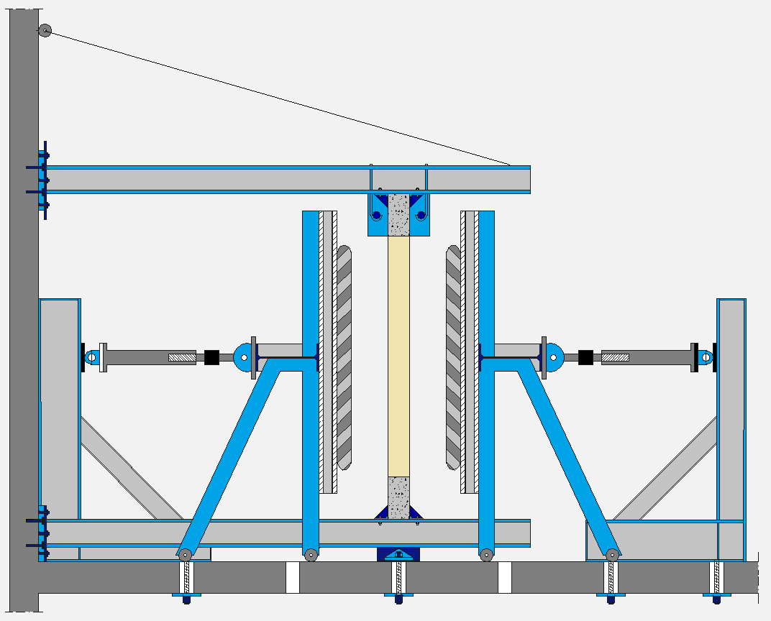
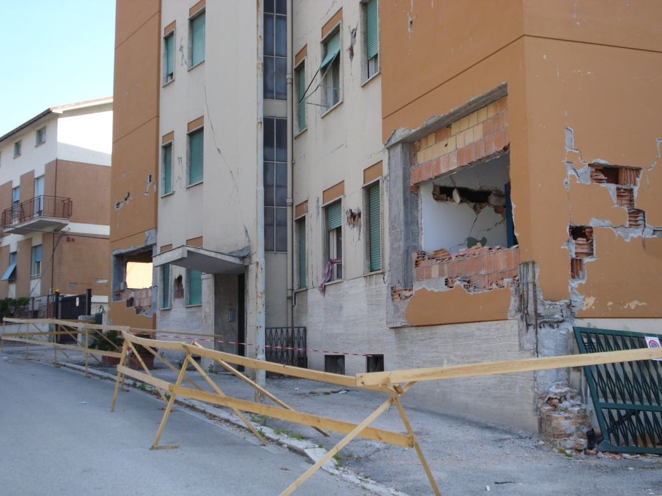
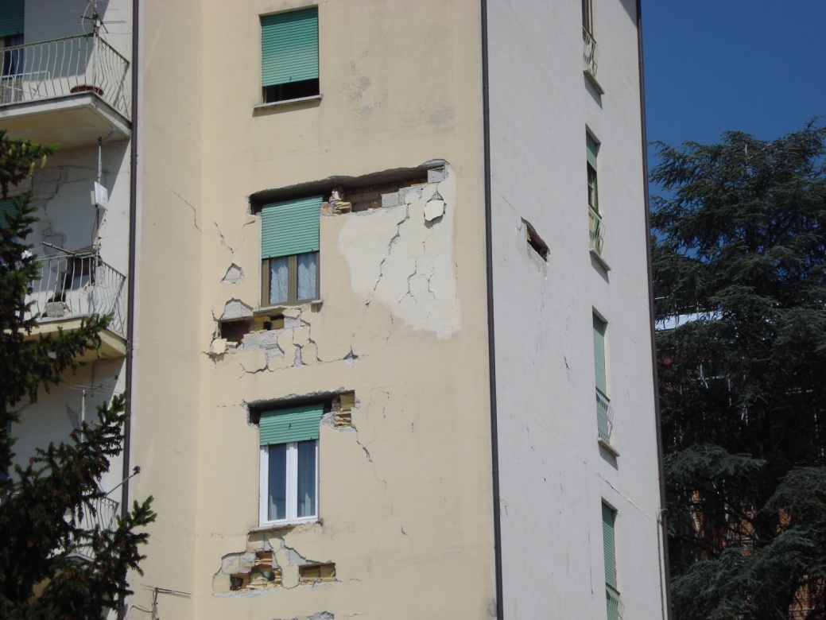
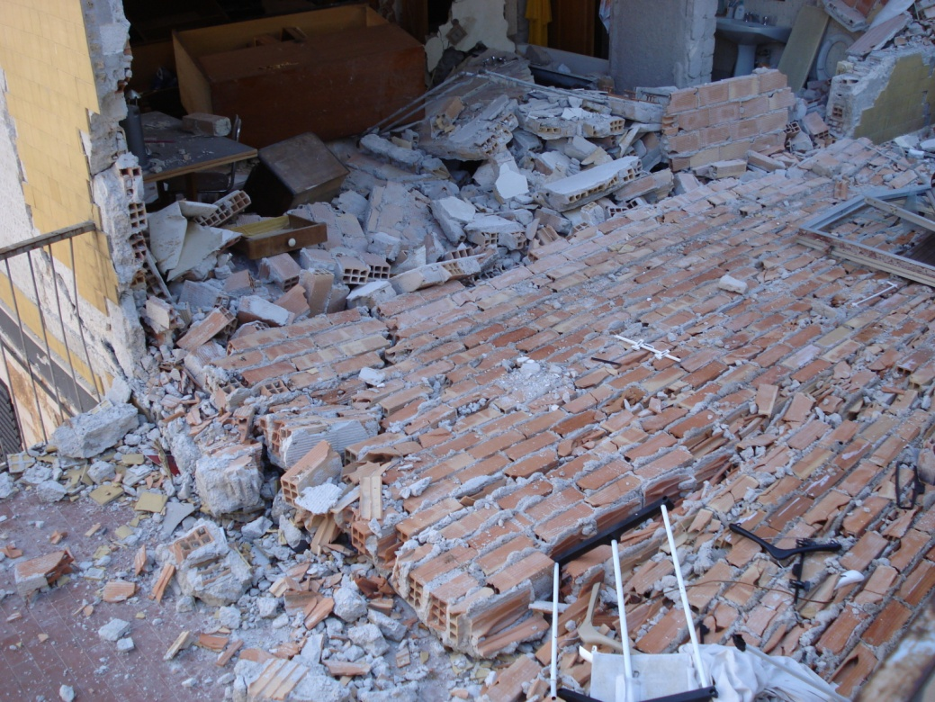
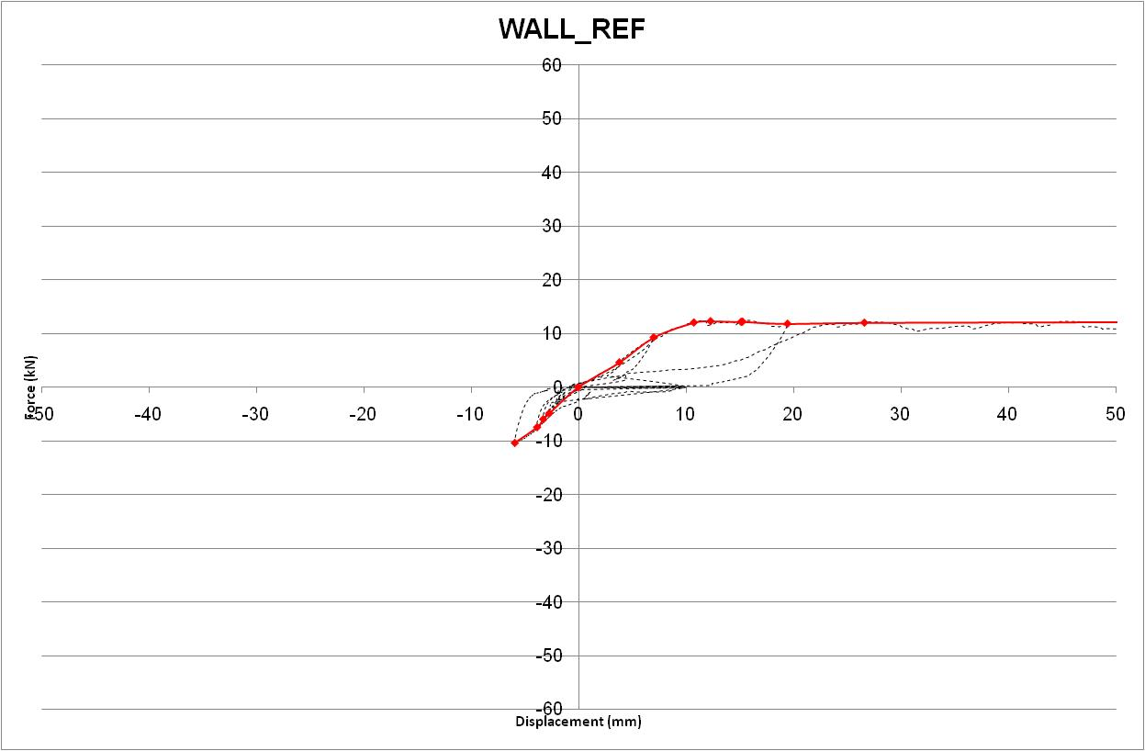
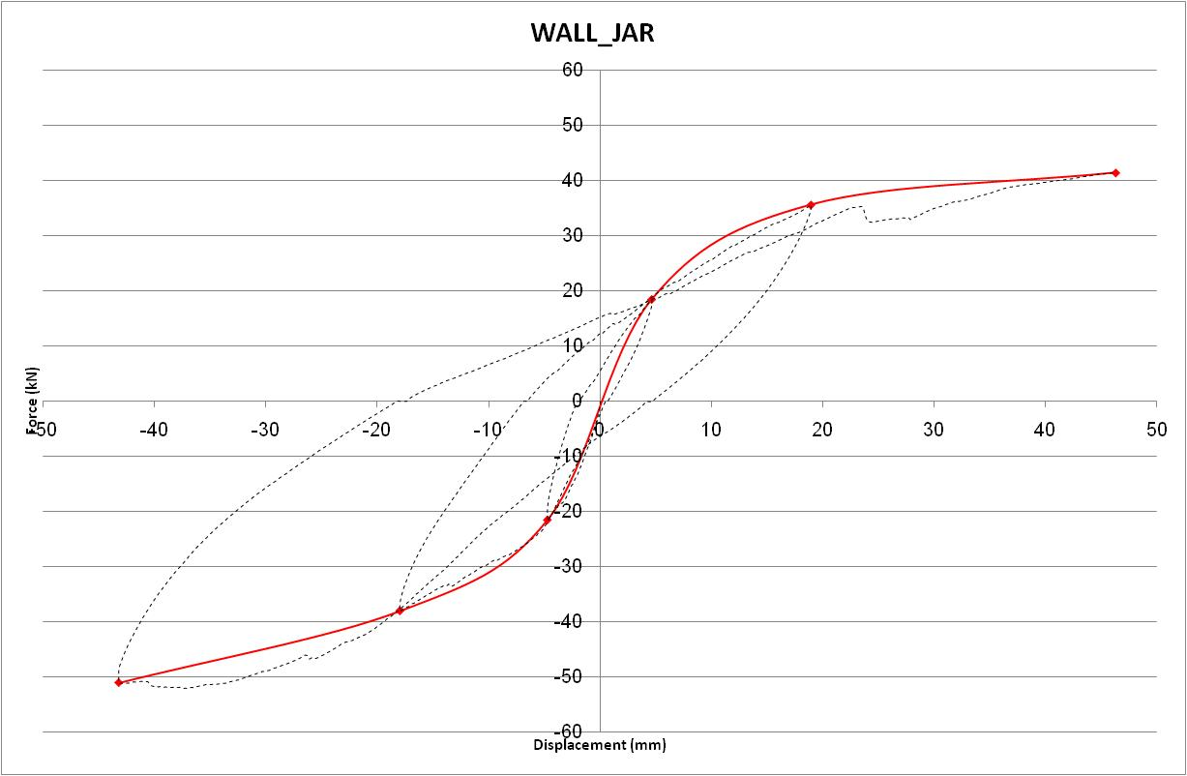
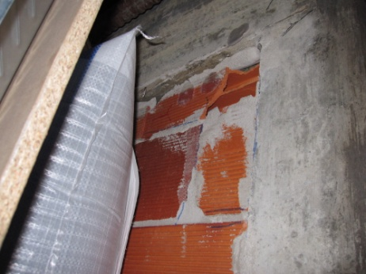
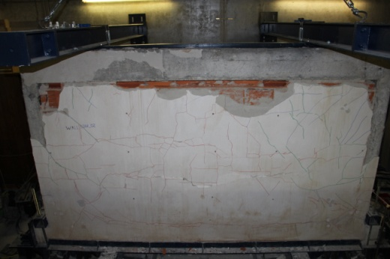
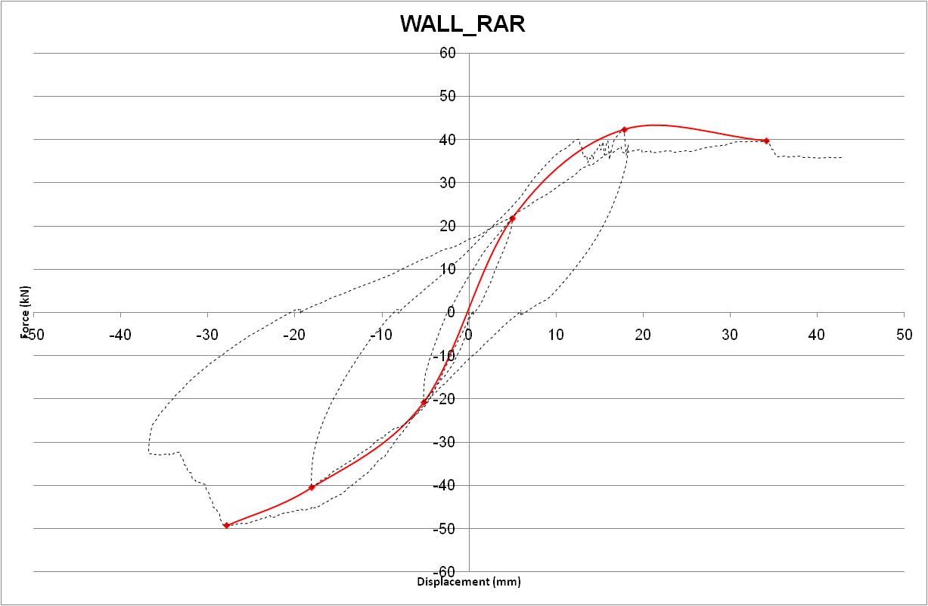
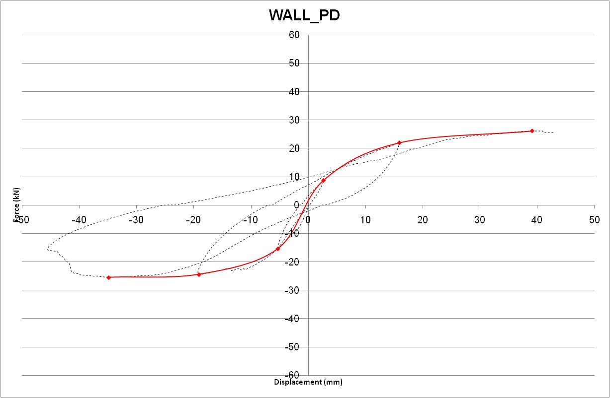
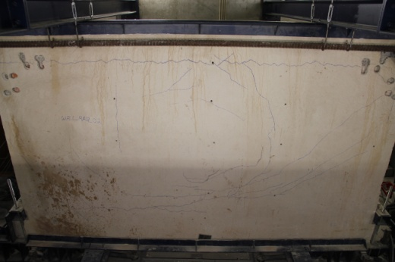
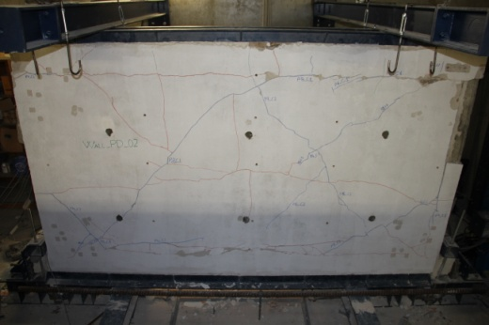
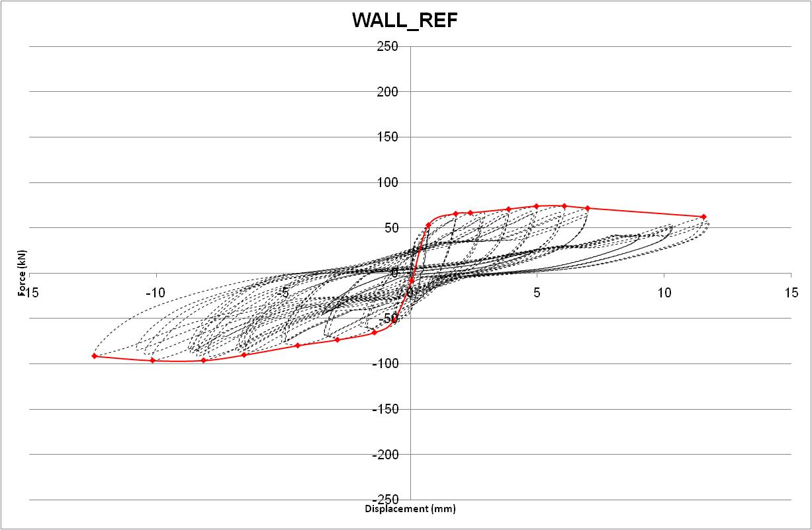
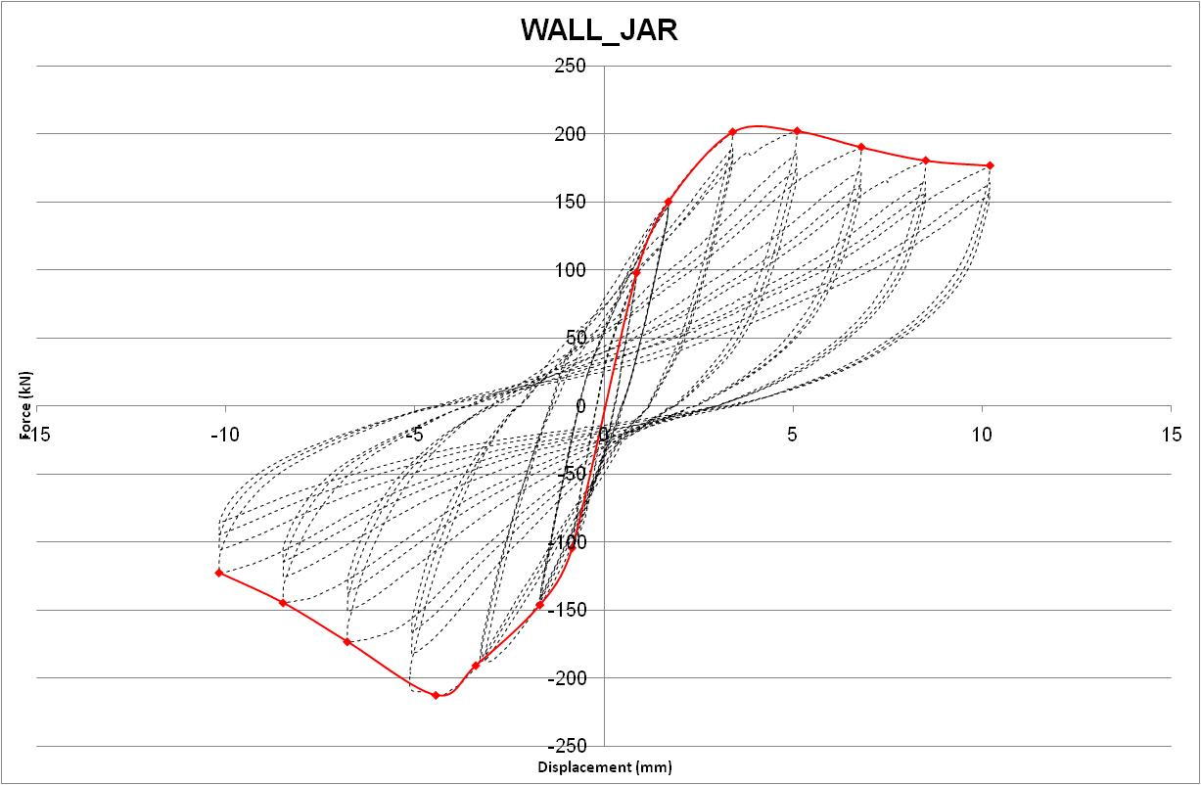
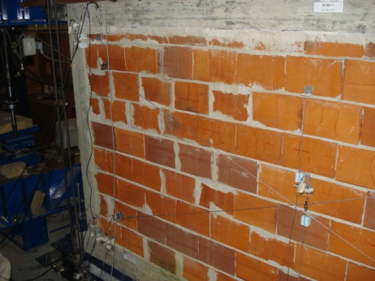
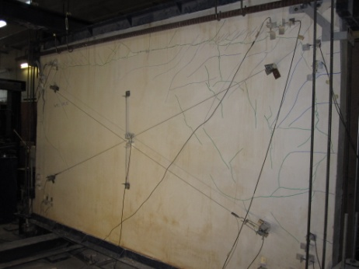
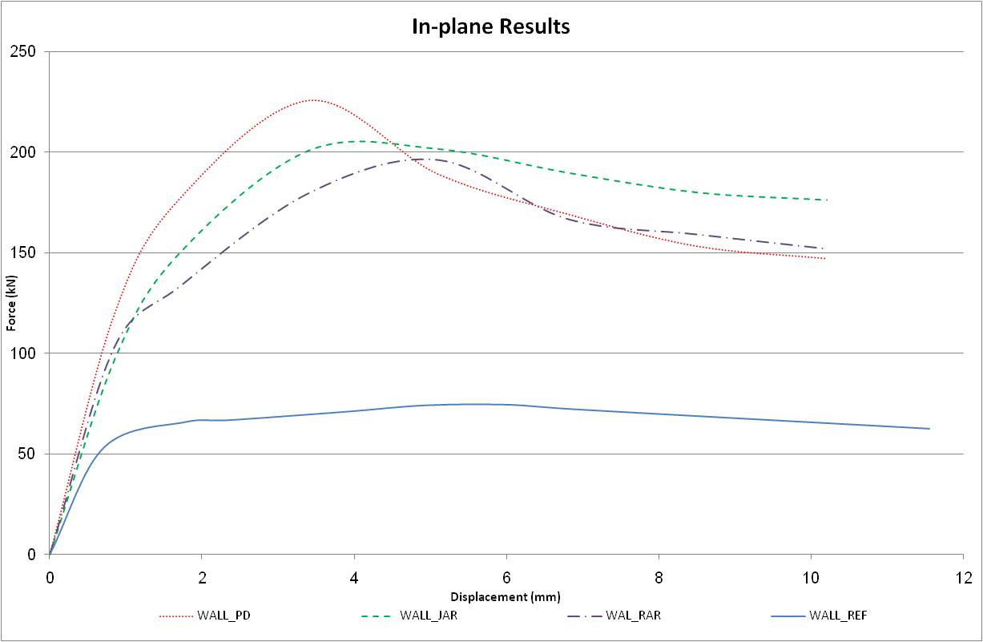
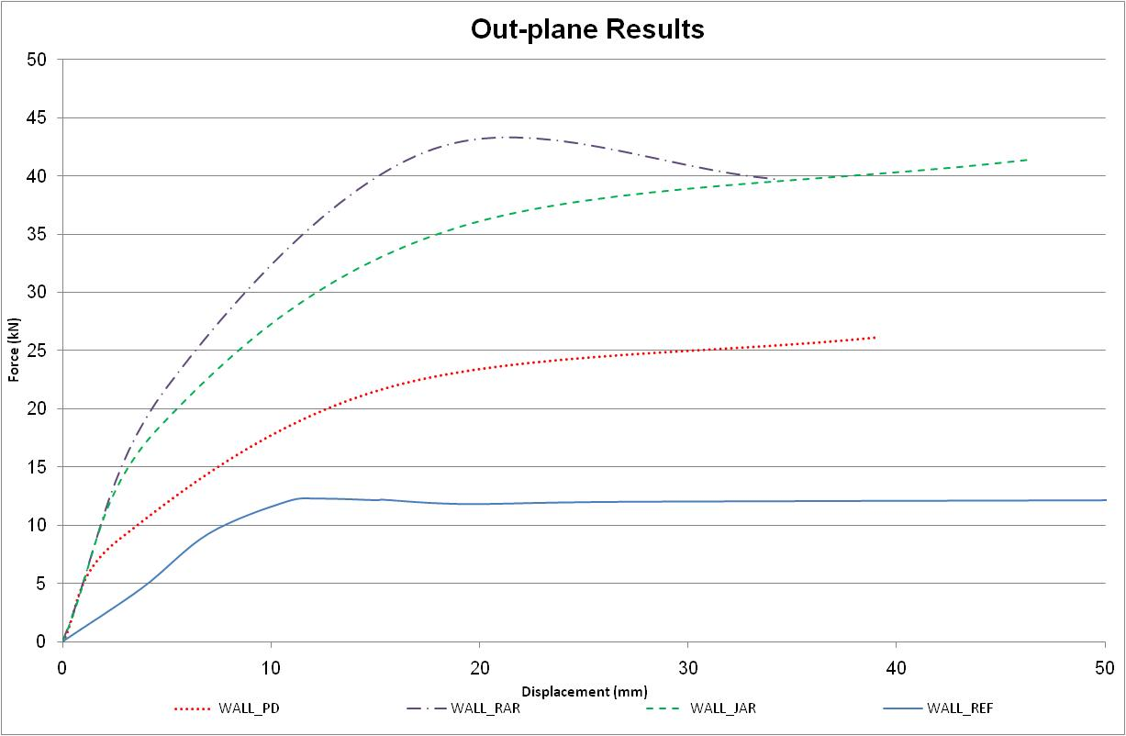
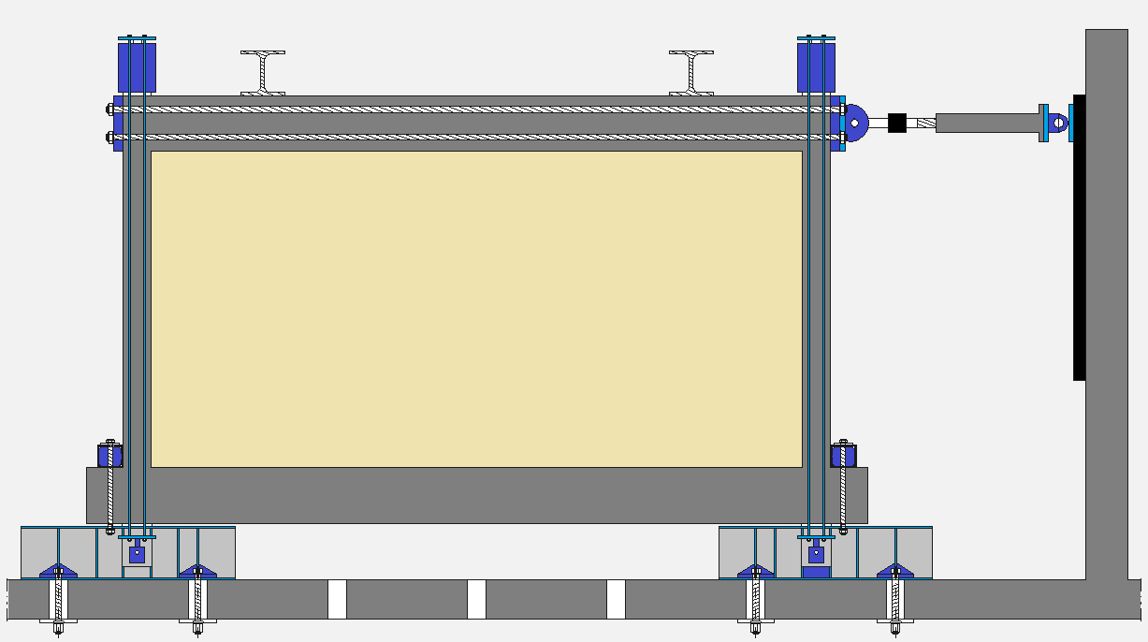
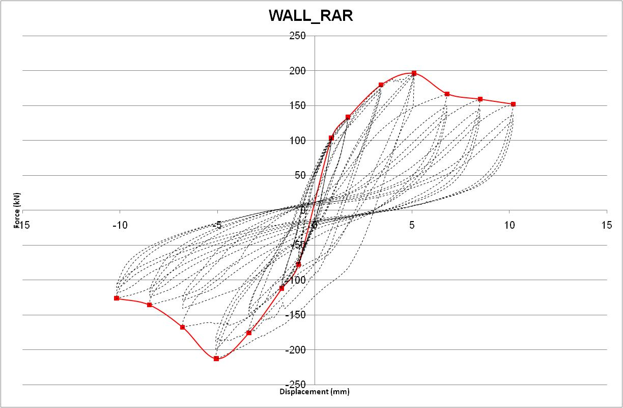
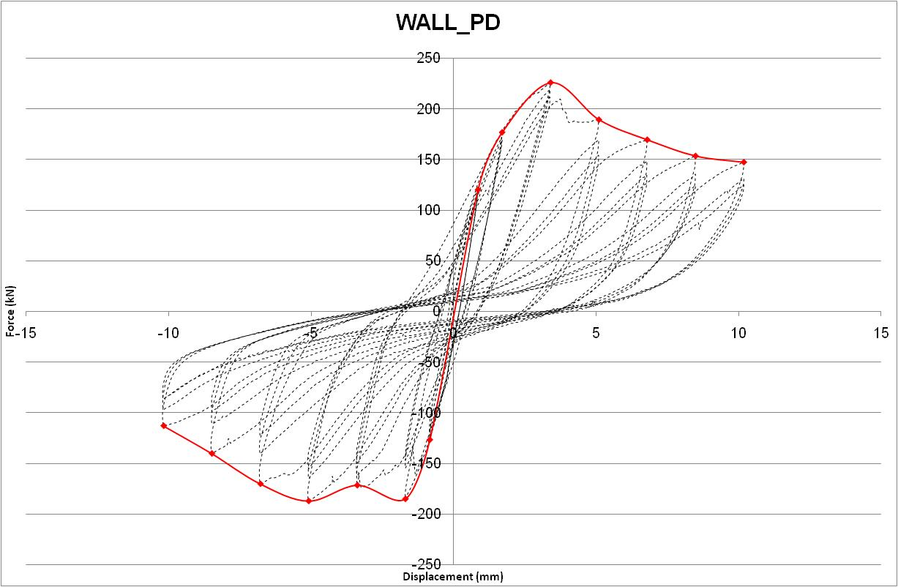
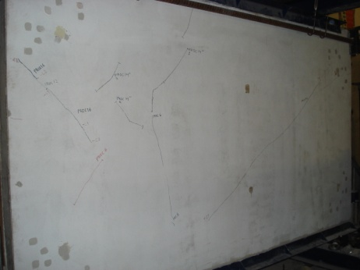
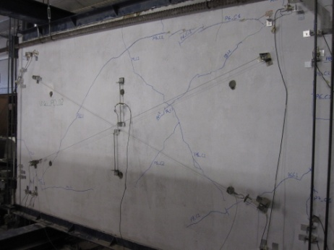
University of Minho School of Engineering Territory, Environment and Construction Centre (C-TAC)
PERFORMANCE’S EVALUATION OF BUILDING’S ENVELOPE TO EARTHQUAKES
Author* M. F. PAULO PEREIRA
Supervisors: J. B. Aguiar, Co-Supervisors P. B. Lourenço and A. Camões
* pp@ppsec.pt
Introduction
Despite its undeniable importance, the masonry walls are usually neglected because of their properties as a constructive element, combined with a lack of tradition in research and teaching, and a lack of careful detailing masonry design. As a result, masonry infills are one of subsystems where there are more defects.
Masonry walls with enclosure and infill functions interact with the structure and contribute to the seismic behavior of buildings, requiring that these walls have adequate performance. In particular, it is necessary to avoid the occurrence of severe damage to the walls in their own plane (leading to serious economic losses) and the out-of-plane collapse of the walls (which could endanger human lives).
This work involves carrying out a series of tests in masonry infill walls, subjected to combined in-plane and out-of-plane tests, as it occurs in real earthquakes. Firstly, cyclic in-plane tests were performed in the walls in order to introduce in-plane damage. Secondly, cyclic out-of-plane tests were performed in order to reach collapse.
Experimental program
The geometry of the masonry walls (3.8 x 2.3 x 0.15 m) was defined taking into account a parallel testing program at a shaking table. From this study, a 1:1.5 scaled building model was defined. The panels considered in the present testing program are part of the building, so that the in-plane and out-of-plane mechanical response can be better understood.
The In-Plane test is performed by applying cyclic horizontal displacements to the masonry panel until it reaches a predetermined value (0.5% drift). The tests were performed applying two vertical loads on the columns, to simulate the presence of the upper storeys.
The Out-of-Plane test consisted on applying displacements to the masonry panel in both directions. These displacements are transmitted to the panel by two actuators, one for each direction. This test consisted of three cycles namely 10 mm, 25 mm and 50 mm, with each cycle repeated twice, one for each direction. The displacements were applied to the panel at a speed of 0.100 m/s.
Four types of masonry walls were studied:
RC frame with infilled masonry (W_REF);
RC frame with infilled masonry with bed joint reinforcement (W_JAR);
RC frame with infilled masonry with external reinforcement (W_RAR);
RC frame with double infilled masonry (W_PD).
Results
In-Plane test
The panel’s behavior in the in-plane test can be described in four phases:
1) All the panel’s elements work jointly (in an elastic way);
2) Nonlinear phase starts to both directions;
3) Maximum resistance is reached;
4) Starts a gradual loss of strength.
Out-of-Plane test
The panel’s behavior in the out-of-plane test can be described in three phases:
1) Elastic behavior can be identified in the first cycle;
2) Plastic behavior is initiated between cycle 1 and 2;
3) In the final procedure there is a large stiffness reduction.
Conclusions
Interfaces are primarily responsible for the non-linear stage.
Previous in-plane damage change the failure mode of the panel due the substantially change of support conditions of the masonry.
Masonry gives to the panel a higher stiffness than the bare frame.
The current design practice ignores the masonry as well its contribution to the structure resistance and to the vibration buildings period in seismic analysis.
W_JAR presents the higher stiffness comparing to the reference wall, thus the W_RAR presents the best behavior in what it takes to drift.
Uma Escola a Reinventar o Futuro – Semana da Escola de Engenharia - 24 a 27 de Outubro de 2011

