Slide 1
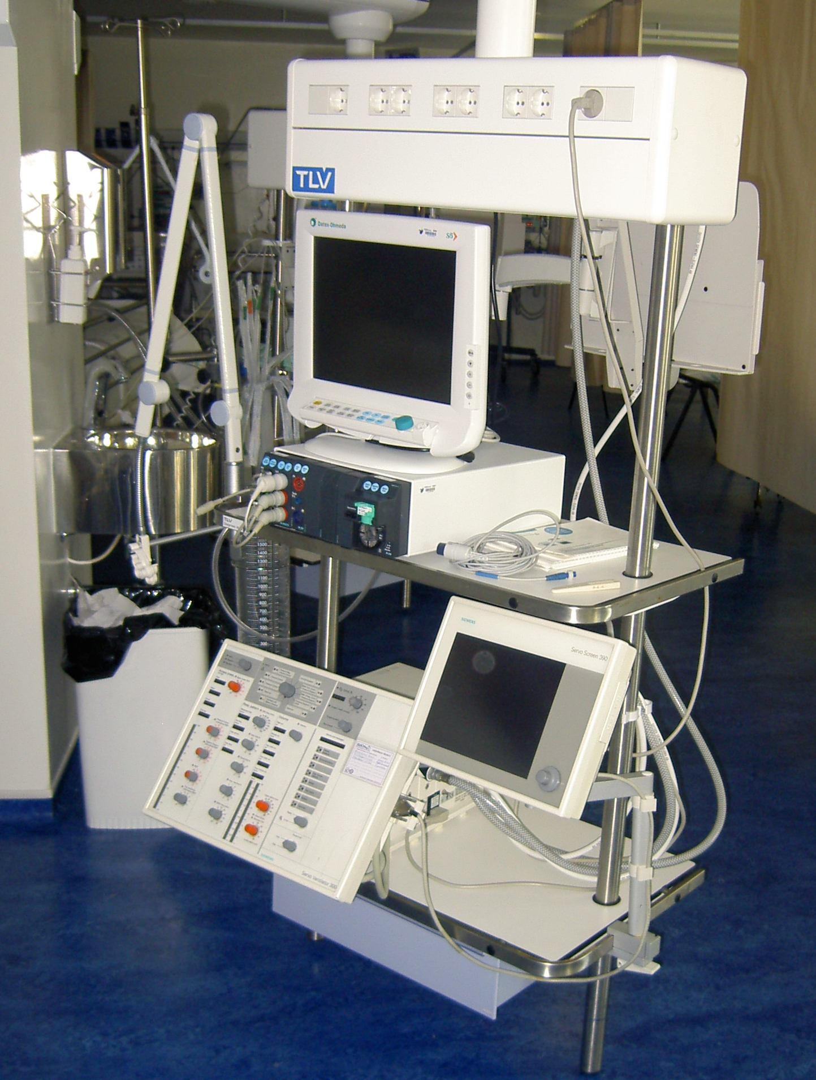
University of Minho School of Engineering <Nome do Centro>
DECISION SUPPORT SYSTEM FOR THE INTENSIVE CARE UNIT
Author* PEDRO GAGO
Supervisors: Manuel Filipe Santos
* pedro.gago@ipleiria.pt
INTCare System
Decision Support Systems (DSS) can be built by applying Knowledge Discovery on Databases (KDD) techniques on the available data.
The KDD process includes data collection followed by data preparation, data mining and results evaluation. All these steps usually require human intervention and are performed off-line.
Nevertheless, there are situations that would be better addressed if one could streamline the process, making it automatic. Automation will allow for situated DSSs capable of adjusting to the environment by sensing and acting upon it.
Our objective is to automate this process by designing situated DSSs based on the KDD paradigm that are capable of acquiring data from sensors, applying data mining algorithms and automatically maintaining the quality of the models in their knowledge base. Finally, the loop will be closed by acting on the environment whenever possible (Figure 1).
When completed INTCare will include:
Real time data acquisition from the bed-side monitors
Up to date model performance information
Automatic model selection based on past model performance
Construction of ensembles of models in order to improve predictive performance
Control of infusion pumps
INTCare is expected to contribute to improve Quality of Service by providing:
Real time, patient adjusted, prediction of organ dysfunction and/or failure
Patient adjusted death probability
Prediction of the length of stay in the ICU
Figure 2: ICU Equipment
A prototype of the system (INTCare) is currently deployed at the ICU of the Hospital Geral de Santo António (Oporto). INTCare’s architecture is presented in figure 3.
With automatic data acquisition from several data sources one must be extremely cautious in order do make sure that data quality is good. INTCare includes agents for data collection and validation from the diverse data sources that can be found in an ICU setting.
Moreover, the knowledge management module is designed in such a way as to allow the system to automaticaly adjust its prediction models as needed. Indeed, INTCare may, in a fully automated manner add or delete predictive models from its model base,
Results so far show the feasibilty of the approach making it easier for doctors to accept it.
Intensive Care Unit
Infusion
Monitor
...
Ventilator
Configuration
Pump
Doctors
Clinical
Data
Data Base
Data
Mining
Knowl.
Base
Decision Support
Figure 1: DSS overview
Prediction
Figure 3: INTCare’s architecture
Uma Escola a Reinventar o Futuro – Semana da Escola de Engenharia - 24 a 27 de Outubro de 2011

