Slide 1


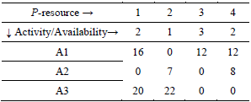

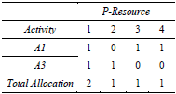

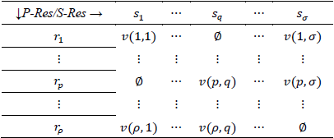
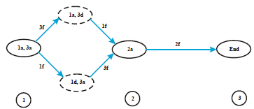

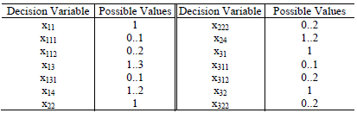

University of Minho School of Engineering CITEPE - Centro Interdisciplinar em Tecnologias da Produção e Energia
RESOURCE COMPLEMENTARITY IN ACTIVITY NETWORKS
HELDER CRUZ DA SILVA*
Supervisors: Anabela Pereira Tereso, José António Oliveira
*helder@ifam.edu.br
Introduction
In this poster we address the issue of optimal resource allocation, more specifically, the resource complementarity analysis in a project activity networks. We developed a conceptual system capable of determining the ideal mixture of resources allocated to the activities of a project, such that the project is completed on time with minimal cost. In this work we report on the development of a computational solution, based on the previous mathematical model developed, capable providing solutions for any activity network.
Problem Description
Consider a project network in the activity-on-arc (AoA) representation: with the set of nodes (representing the “events”) and the set of arcs (representing the “activities”), denoted by G=(N,A).
Activity-on-arc (AOA) representation. Network
with three activities.
|N| = n and |A| = m (representing the “events”) and the set of arcs (representing the “activities”). Consider a set of p and s resources with |p| = ρ and |s| = σ.
The impact of Rs on the Rp resource can be defined by:
Applicability and
impact of support
resources
The duration of activity based on Rp and Rs availability is given by,
Where, “y” is the activity duration, “x” is quantity of resources working in activity and r_{p} and r_{s} are primary resource and support resource.
Mathematical Model
Assuming all costs are linear or piece-wise linear in their argument, we have:
Total allocation of resource (including complementary resources) in activity,
Defining the activity’s duration y(a) as the maximum of individual resource durations:
The cost of resource c_{R} utilization is quadratic in the resource allocation for the duration as denoted below,
The earliness-tardiness costs are linear in their respective marginal values, as shown
The desired objective function may be written simply as
Description of the procedure adopted and results
Based on three activities network we have define the state space diagram, as shown below (a=active, d=dormant and f=finished)
From work content table and the state space, we have
The p-resource allocation on time 0 is:
The total duration based on analysis is:
For support resource r_{s} = 0, we have:
Considering the s-resource availability (PS-matrix) the duration of A3 will be:
The total duration is:
Cost analysis:
After repeating this procedure for all possible combinations, we came up with a solution of this network:
Conclusion
The goal of this paper was to provide a formal model to some unresolved issues in the management of projects, especially as related to the utilization of supportive resources. The relevance of the problem is the opportunity to shape a system that allows not only that we improve the allocation of often scarce resource(s), but also result in reduced uncertainties within the projects, combined with increased performance and lower project costs. In this paper we presented the procedure developed to solve the mathematical model and we applied it to two simple networks, obtaining the desired results, through an initial implementation in C.
We believe it can provide to user a new option to plan and to determine the best combination of resources and the lowest project cost, pushing the planning phase and increase the estimation ability of the companies.
degree of enhancement of P-resource by S-resource
Total of Rp including Complementarity
work content of activity when P-resource is used
Cost of Rp
Cost of Rs
Cost
Activity Total Cost
Cost tardiness
Tardiness (delay)
Cost earliness
Earliness
Minimal Total Cost
Work Content
Decision Variables and Possible Values
P-S matrix
Xaps – a: activity, p: p-resource and s: s-resource
Uma Escola a Reinventar o Futuro – Semana da Escola de Engenharia - 24 a 27 de Outubro de 2011

