Slide 1
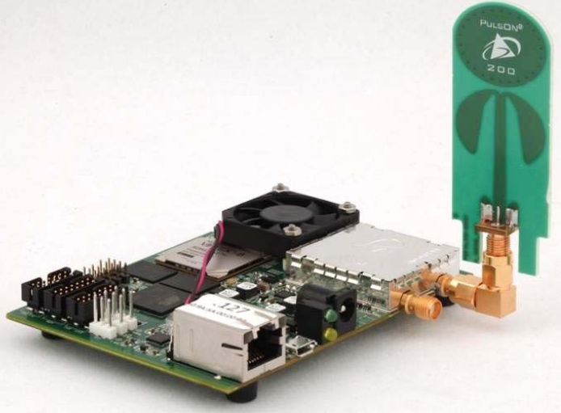
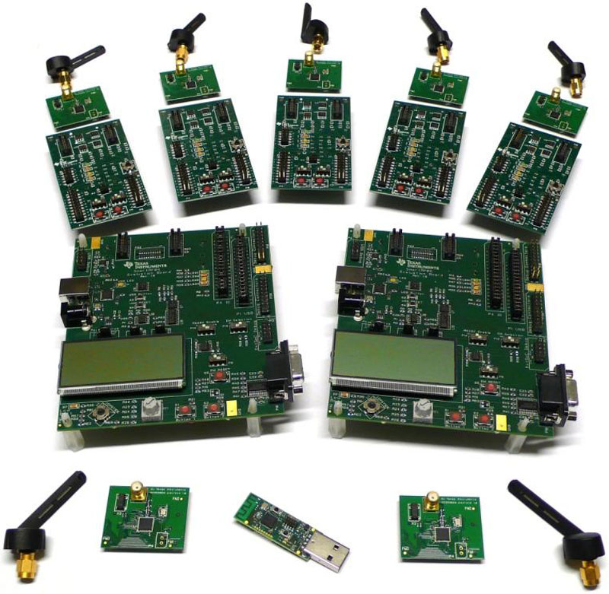
University of Minho School of Engineering <Nome do Centro>
SENSING COMPLEX ENVIRONMENTS WITH LOCALIZATION REQUIREMENTS
Author* ANTÓNIO JÚLIO PIRES
Supervisors: Paulo Mateus Mendes, Co-Supervisor: Sérgio Monteiro
* ID2512@uminho.pt
ABSTRACT
Two areas that are at present being developed, are smart materials and smart environments. This intelligence is based on the ability to measure and collect various distributed physical variables. This information is acquired, collected and transmitted by wireless sensor networks.
Of the many known technologies such as IEEE802.15.1 (Bluetooth), IEEE802.15.4 (Zigbee) and 802.11 b/g/n (Wi-Fi), one that has been widely implemented for sensing purposes, is the Zigbee.
However, this type of technology can become quite inefficient when the network size increases. A solution that can satisfy the wireless sensor networks requirements and in recent years has aroused great interest in the community is Ultra Wideband technology, and its development started a new era in short and very short range communications.
In this work, the Ultra Wideband will be explored as a solution to deploy complex (high throughput, high node number, non-homogeneous traffic) wireless sensor networks with location requirements.
INTRODUCTION
Since there is a tendency for a higher temporal and spatial resolution, sensor networks have an increasing complexity due to the high number of sensors that are expected in a particular environment.
Also the fact that this information is dependent on where it is collected, it is of utmost importance to have accurate information about the exact location of the sensor, which is still quite complex when it comes to indoor environments.
The application of Ultra Wideband (UWB) technology, due to its many benefits, in particular: the low cost of transceivers, the ability to communicate at high speeds with high throughput and spatial resolution for very short distances; it is an asset to the continued development of wireless sensor networks (WSN), having received much attention in recent times, both from industry and academia.
STATE-OF-THE-ART
Beyond the most common technologies such as IEEE802.15.1, IEEE802.15.4 and 802.11 b/g/n, there is also a proposal for WSN with very low consumption, known as DUST. But they can be very inefficient for several reasons.
WSN also got requirements for node geolocation with a high degree of accuracy, but most WSN are based on transmission schemes for narrowband, so beyond the number of nodes running at the same time be very limited, the solutions used for geolocation does not give the necessary accuracy for very short distances.
However, the UWB use very high signal frequencies (in the order of GHz) allowing a higher temporal resolution and high accuracy for short distances. Given also a solution that in recent years has aroused great interest in the community is UWB technology, and its development started a new era in short and very short range communications.
Requirements for WSN and UWB technology applicability
The main objective of the network is to communicate the sensor data, taking into account constraints of delay and reliability.
The requirements for the transceivers in a WSN are given by the standard Zigbee: low cost (for mass production), small size e low consumption. Some additional requirements are necessary to make effective the WSN: robustness, variable data throughput e heterogeneous network.
Apart from data communication, geolocation is another key aspect for many applications of WSN. The UWB technology can give an answer to all of these requirements.
Comparison between existing technologies
ULTRA WIDEBAND FOR WIRELESS SENSOR NETWORKS
The first step of the work was to perform a survey of existing UWB technology, to verify its appropriateness and applicability in WSN, specifically in complex sensory and high-density materials and intelligent environments. For this, it becomes necessary to check and study the mathematical theory involving the UWB technology, considering some previous studies.
However, only the use of physical devices allows real proof and correct measurement of the key parameters, such as checking the accuracy of detection distances of less than 5m. To do so, there will be some study and tests of UWB technology available devices, including: UWB Radar Evaluation Kit GZ6EVK from Geozondas, P220 Evaluation Kit and P400 RCM Development Kit from Time Domain.
It is intended to carry out the implementation of COTS components, in conjunction with other technologies such as Zigbee (using CC2530 Zigbee Development Kit from Texas Instruments) and WiFi.
It is necessary to provide a reasonable QoS for wireless communications as well as a geolocation immune to environmental dimension and noise.
Uma Escola a Reinventar o Futuro – Semana da Escola de Engenharia - 24 e 27 de Outubro de 2011

